Slide 1



Socio-technical aspects of AI-powered deepfake fraud
Meropi Tzanetakis
University of Manchester
Workshop on General-Purpose AI: Prospects and Risks
EnnCore Project
9th June 2025, University of Liverpool

Slide 2
Overview
What is the problem?
What is the solution?

Slide 3
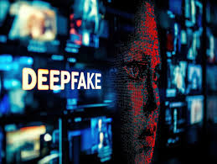
What is the problem?

Slide 4
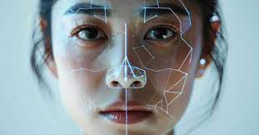

Deepfake: Dual-use dilemma
innovative applications
high potential for criminal use

Slide 5
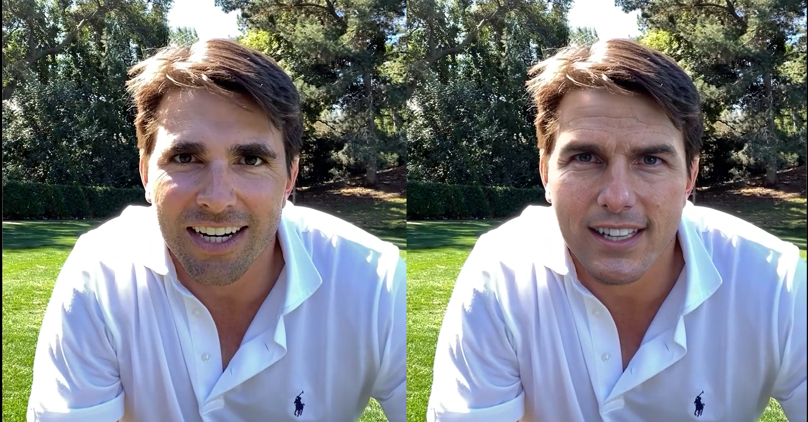
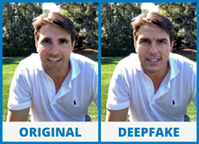
Use cases
Entertainment industry
Advertising
Education

Slide 6
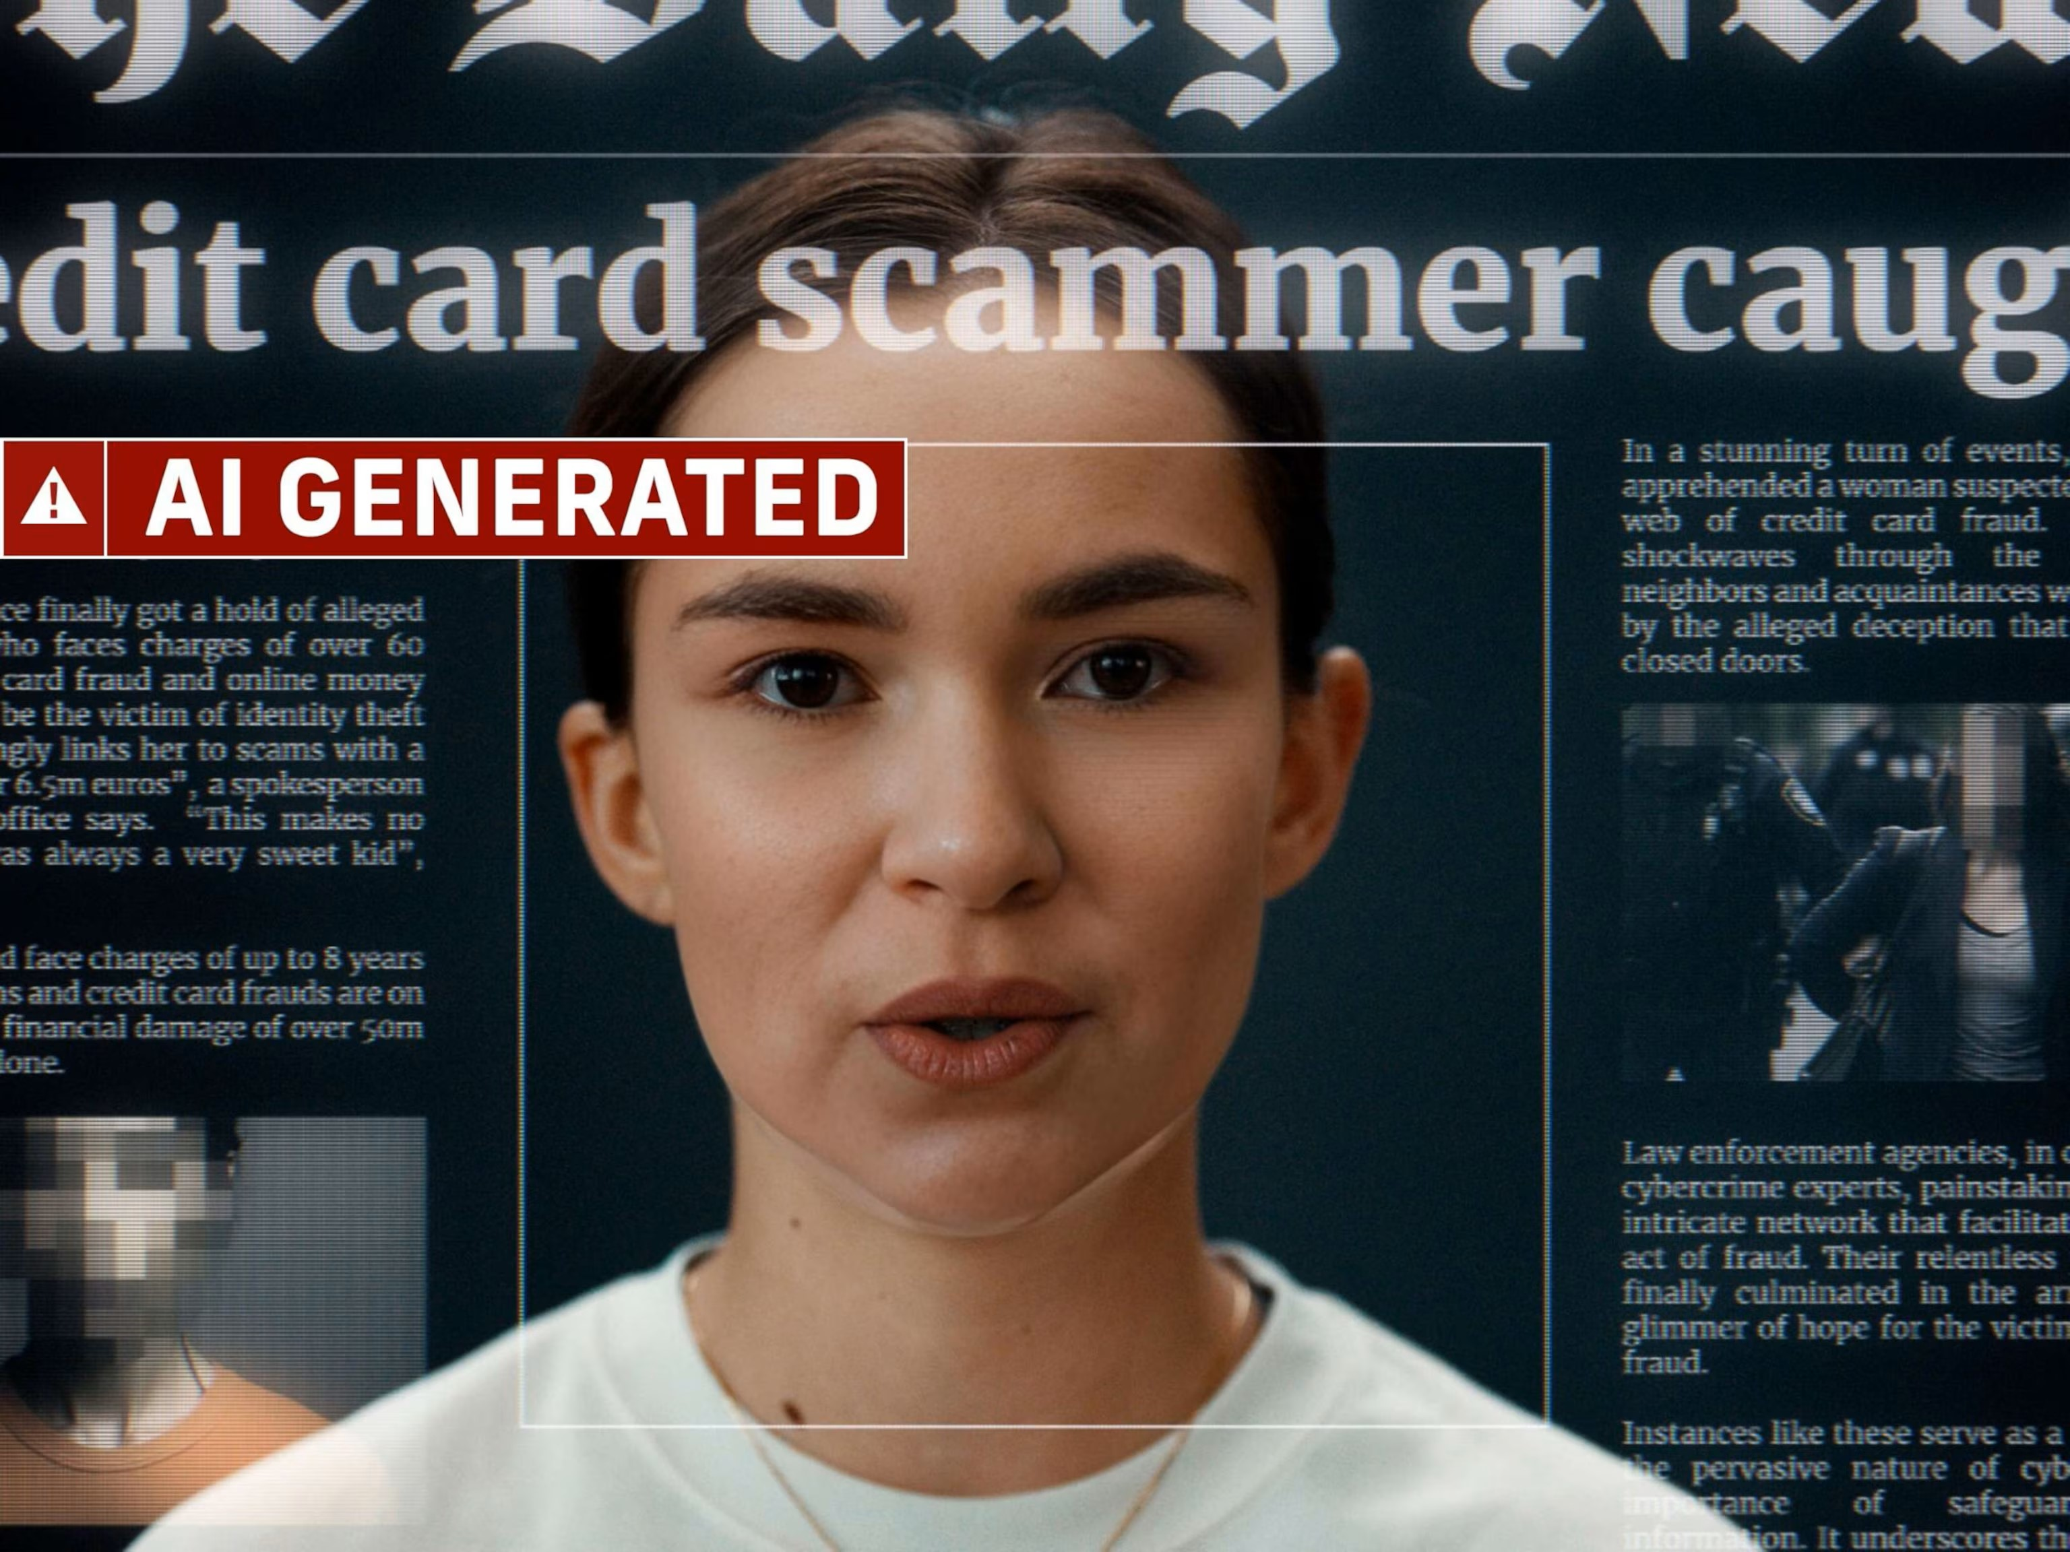
Cybercrime
Deception, fraud
Financial crimes
Identity theft
Misinformation
Extortion
Erosion of digital trust
(Europol 2022)

Slide 7
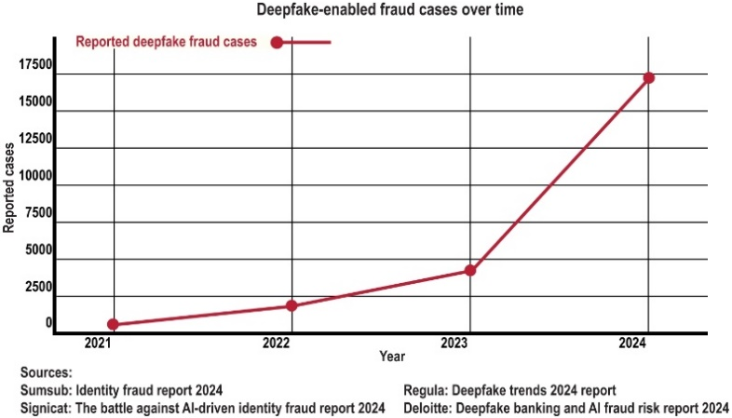
Deepfake fraud cases

Slide 8
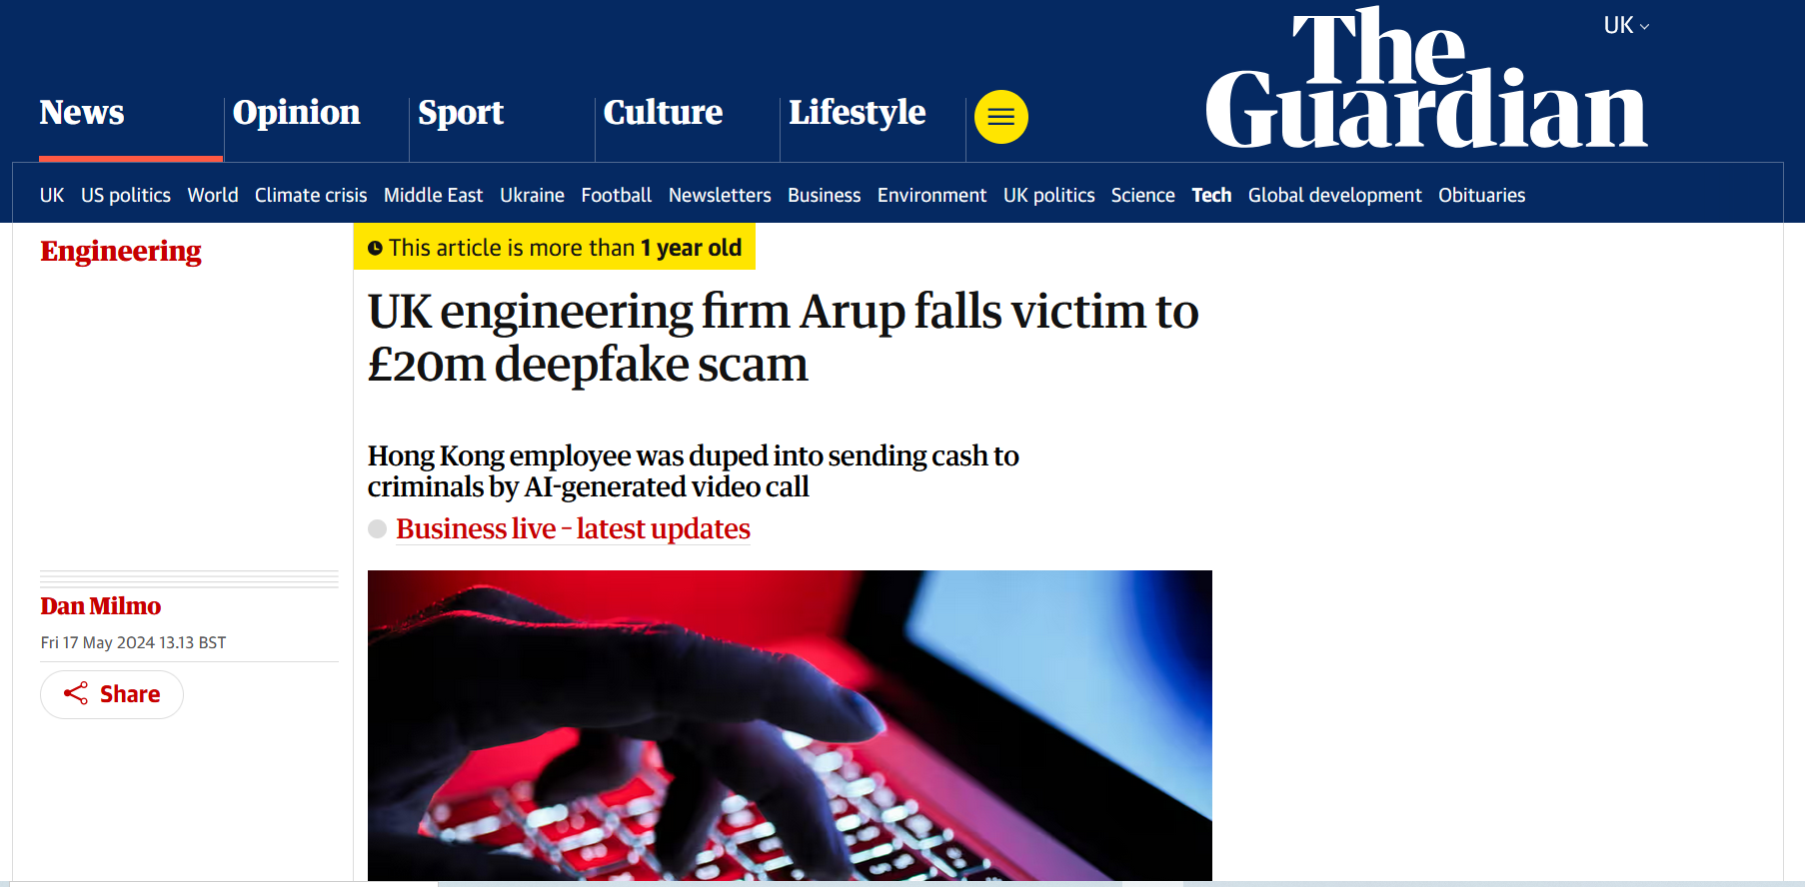

Slide 9
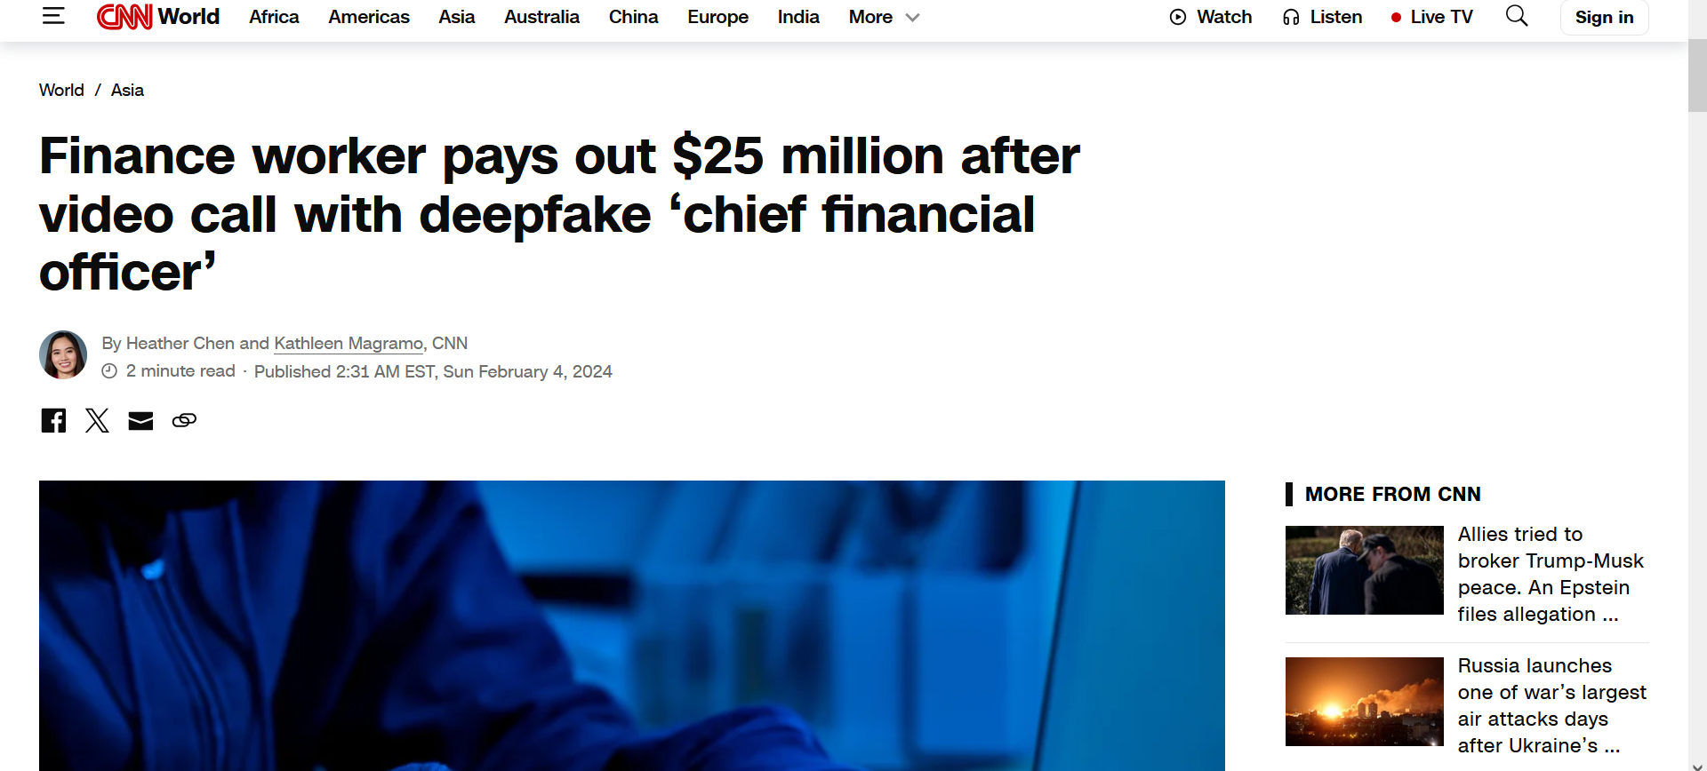

Slide 10
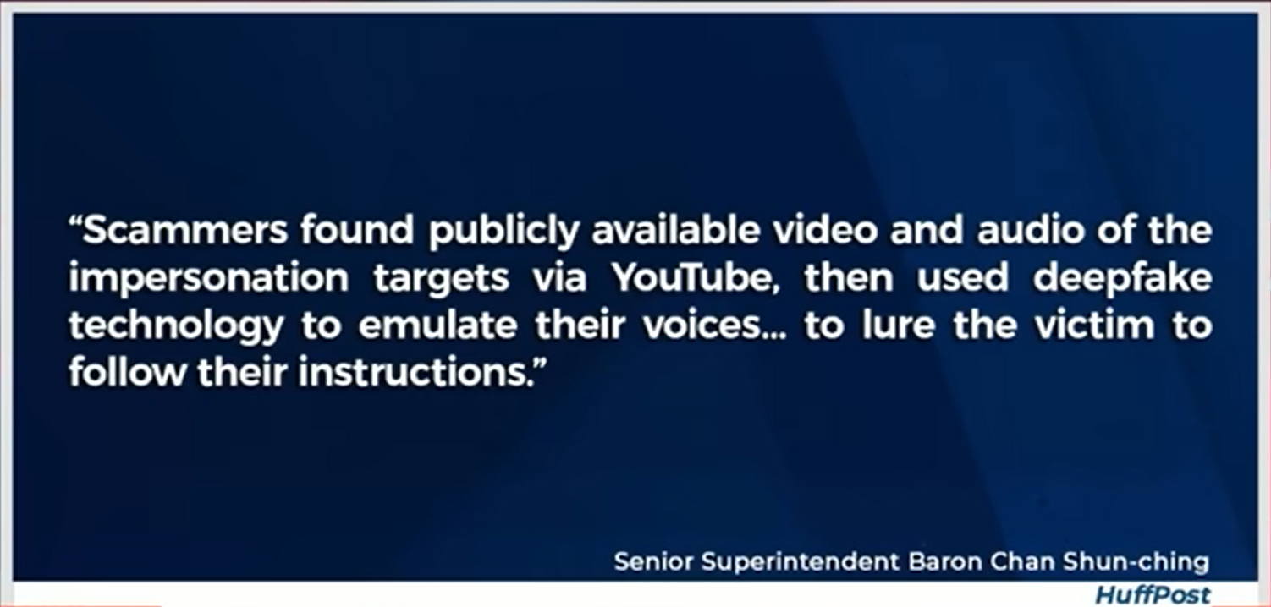

Slide 11
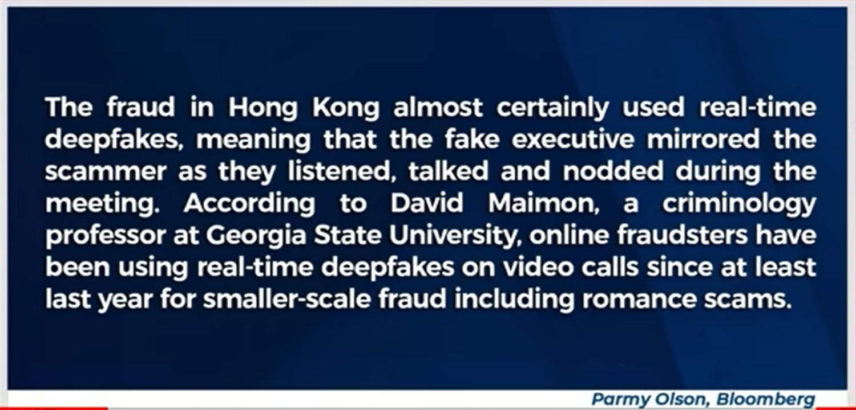

Slide 12
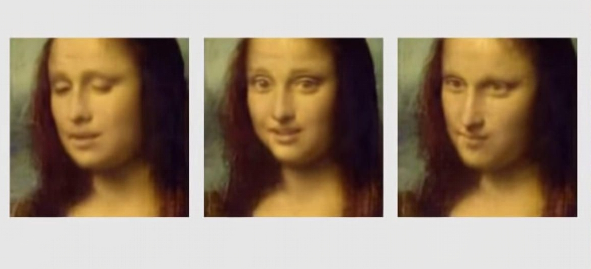
What is the solution?

Slide 13
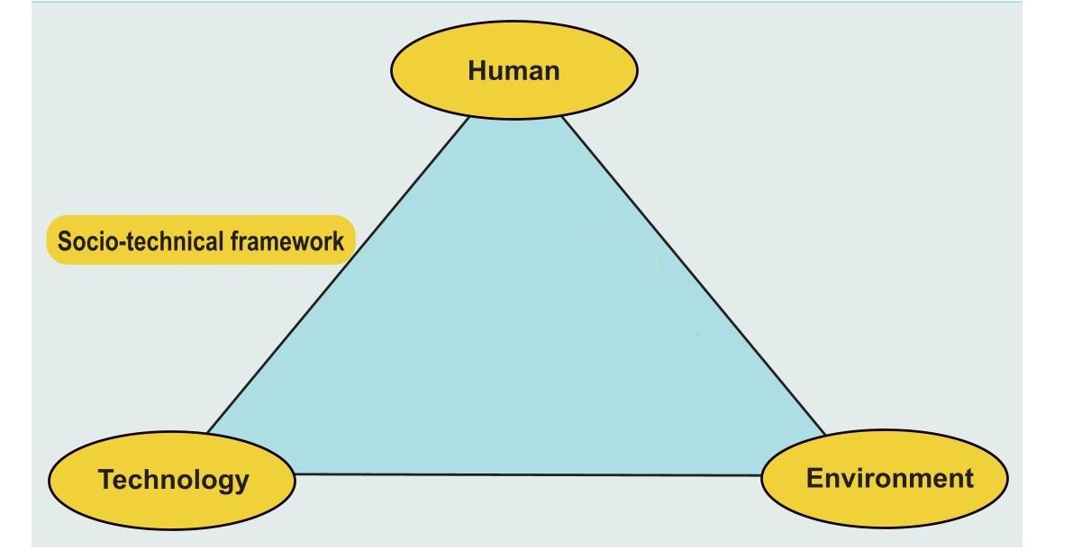
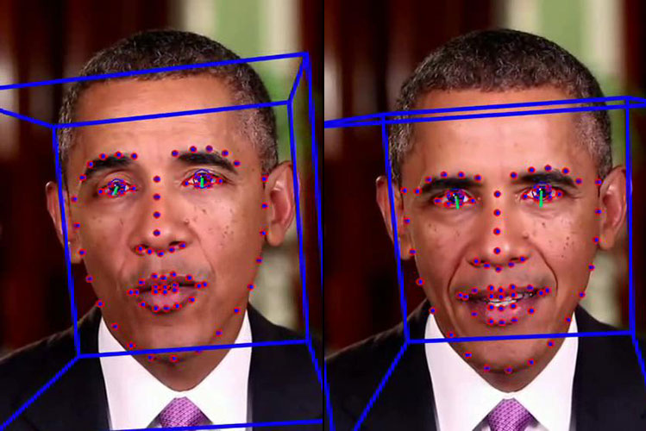
Socio-technical approach

Slide 14
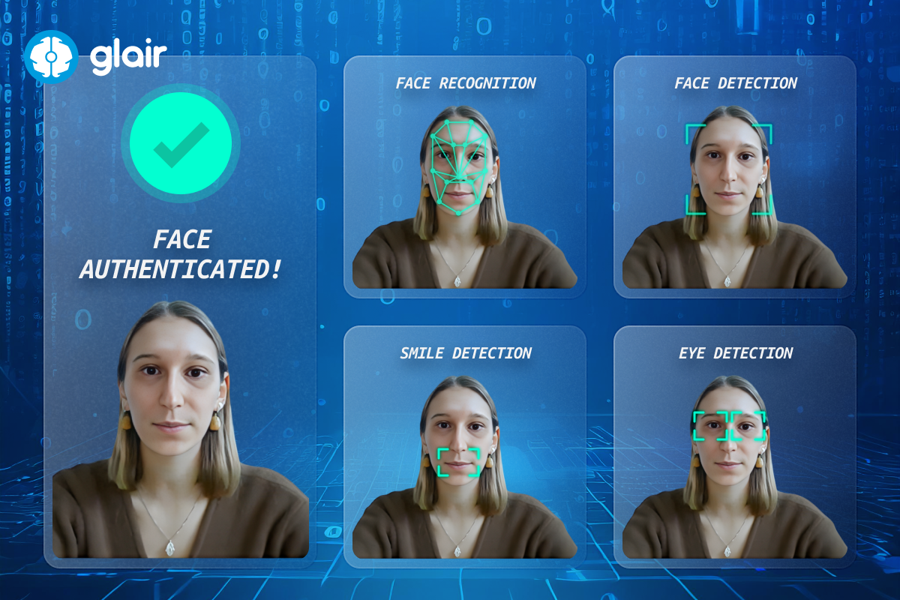
Pillar I: Technology
Limitations of deepfake detection tools
Struggling to keep pace with AI’s growing sophistication
How do offenders exploit deepfake technology to bypass detection systems?

Slide 15
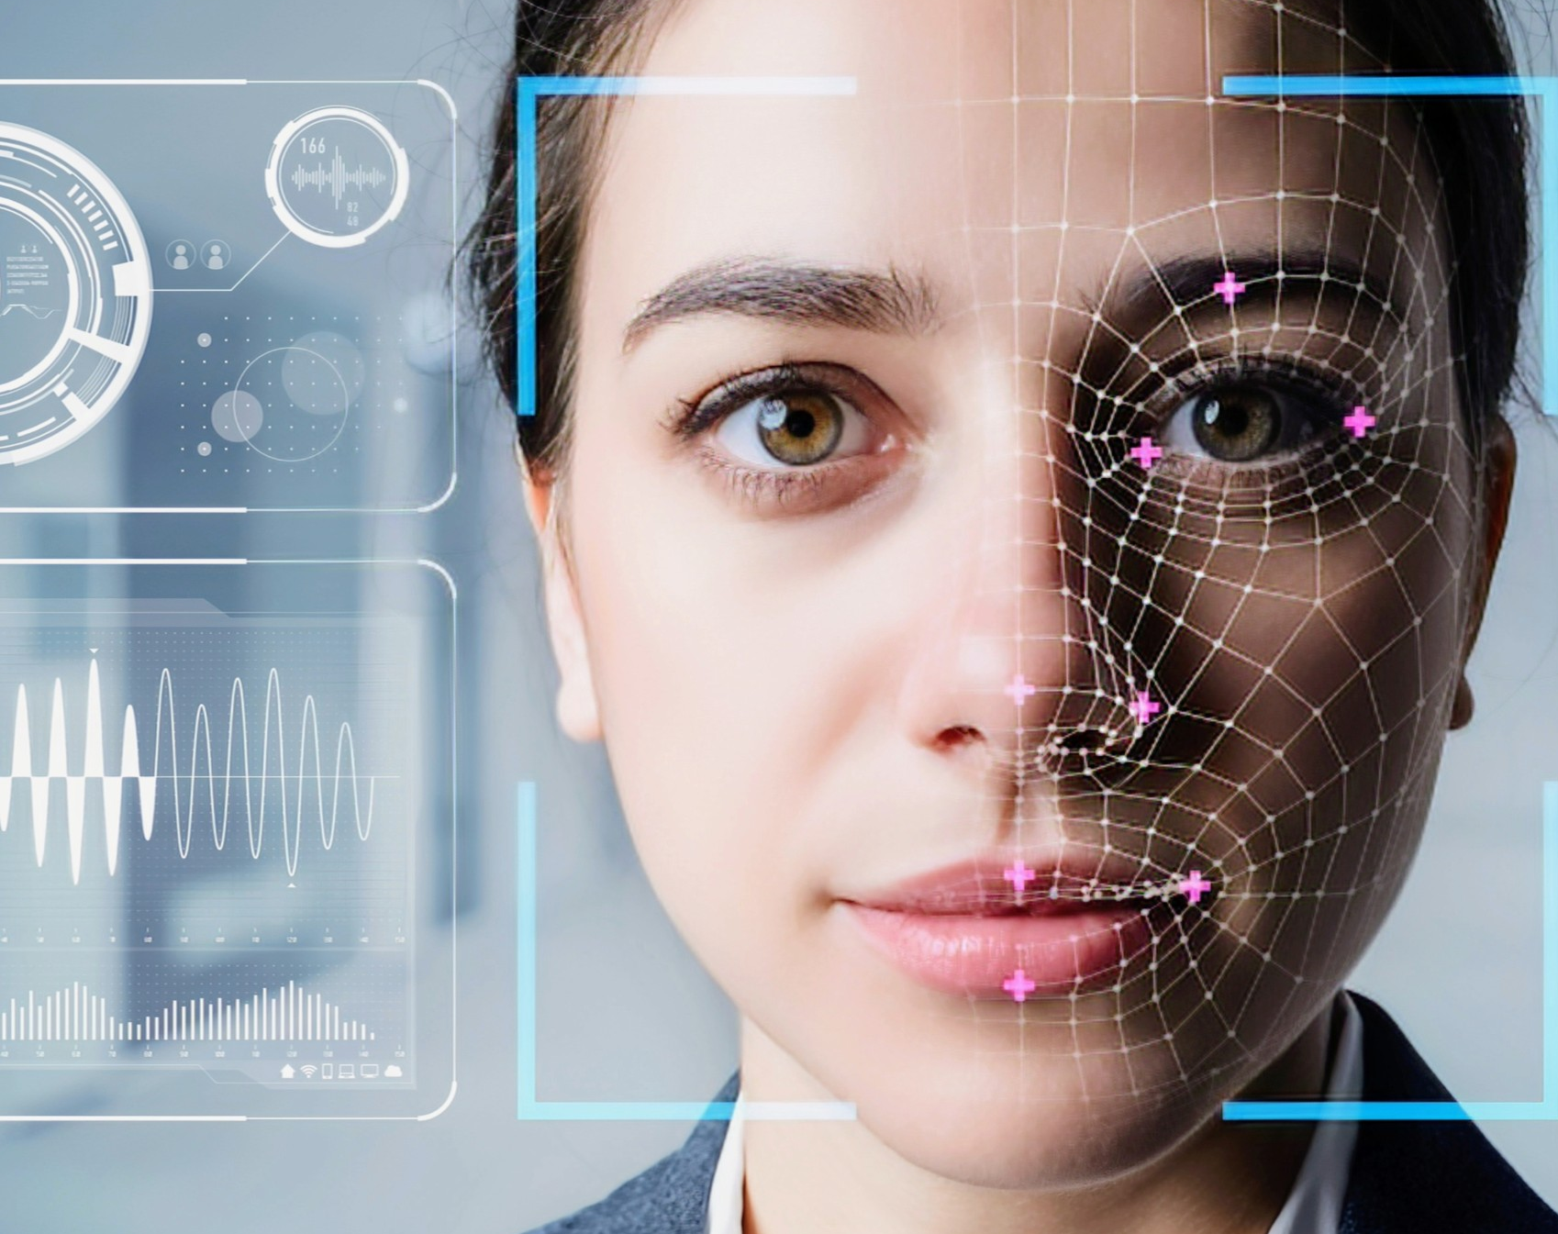
Pillar II: The human factor
How do offenders use deepfake technology for fraud?
What are the motivations driving offenders?
What are the risks of becoming a victim? – for individuals, - for organisations

Slide 16

Pillar III: Environment

Slide 17
Countermeasures against deepfake fraud
Deepfake detection
Prevention: public awareness
Legislation: GDPR, DSA, AIA

Slide 18
Thank you!
Meropi Tzanetakis
meropi.tzanetakis@manchester.ac.uk
https://at.linkedin.com/in/meropitzanetakis
@MeropiTzanet

